Slide 1

Presentation Repeaters 2024 - 2025
Session - 01
PHYSICS

Slide 2
LAWS OF MOTION

Slide 3

FORCE
Effect of Resultant Force
May change only speed
May change only direction of motion
May change both the speed and direction of motion
May change size and shape of a body

Slide 4
Unit of force :
S.I system – Newton (N) or Kgm/s²
C.G.S system – dyne or gcm/s²
1 N = 10⁵ dyne
Dimensional Formula of force : [MLT⁻²]
For full information of force, we require
Magnitude of force
Direction of force
Point of application of the force

Slide 5
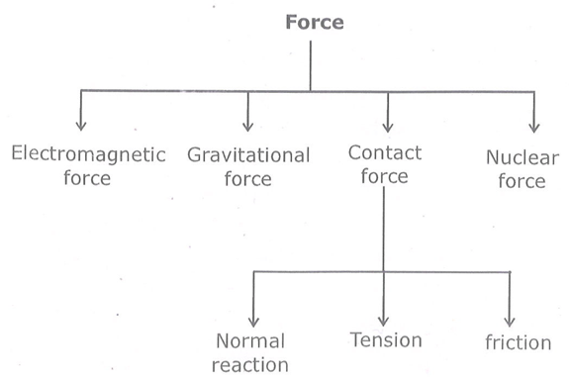
Type of Force

Slide 6
NEWTONS FIRST LAW OF MOTION
Inertia is the idea obtained from Newtons first law
Mass is the measure of inertia. That is as mass increases inertia also increases.
Different Types of inertia :
Inertia of Rest
Inertia of motion
Inertia of Direction

Slide 7
Class Assignment Question
When a train stops suddenly, passengers in the running train feel an instant jerk in the forward direction because
The back of seat suddenly pushes the passengers forward
Inertia of rest stops the train and takes the body forward
Upper part of the body continues to be in the state of motion whereas the lower part of the body in contact with seat remains at rest
Nothing can be said due to insufficient data

Slide 8
MOMENTUM
Momentum = Mass x Velocity
P = mV
It is a vector quantity
Unit → Kg m/s
Dimension – [MLT⁻¹]
Q : Suppose a car of mass (m) and a truck of mass (M) are moving with the same velocity. Which one will have greater momentum? Why?
Q : Suppose a car and a truck have same momentum. Which one wil have greater velocity? Why?

Slide 9
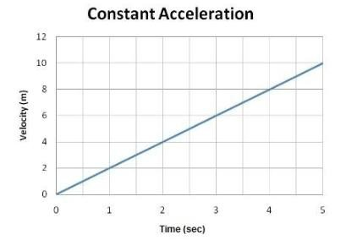
1. For same body moving with different velocity
P V.
If V1 > V2
P1 > P2

Slide 10
2. For different bodies moving with same velocity
P m.
If m1 > m2
P1 > P2
P
V = Constant
M →

Slide 11
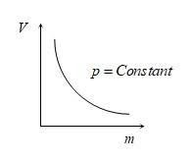
3. Two bodies having same momenta
m1v1 = m2v2
m1 > m2 v1 < v2

Slide 12
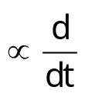


NEWTONS SECOND LAW OF MOTION
Force & Rate of change of momentum
F ^{(P)} ; F ^{(mV)}
Or F = ma
For variable mass system (Eg, Rocket propulsion)
F = ^{(mu)} or
F = u

Slide 13
Class Assignment Question
Q : If a bullet of mass 5 gm moving with velocity 100 m/sec, penetrates the wooden block upto 6 cm. Then the average force imposed by the bullet on the block is
1. 8300 N 2. 417 N 3. 830 N 4. Zero

Slide 14
Q : A machine gun is mounted on a 2000 kg car on a horizontal frictionless surface. At some instant the gun fires bullets of mass 10 gm with a velocity of 500 m/sec with respect to the car. The number of bullets fired per second is ten. The average thrust on the system is
1. 550 N 2. 50 N 3. 250 N 4. 250 dyne

Slide 15
Q: A force vector applied on a mass is represented as
and accelerates with 1 m/s². What will be the mass of the body.
1. kg 2. kg 3. 10 kg 4. 20 kg

Slide 16
Q:A ball of mass m moves with speed v and it strikes normally with a wall and reflected back normally, if its time of contact with wall is t then find force exerted by ball on wall
1. 2. 3. mvt 4.

Slide 17
Q : A particle moves in the xy-plane under the action of a force F such that the components of its linear momentum p at any time t are p_{x} = 2cos t, p_{y} = 2sin t. The angle between F and p at time t is
1. 90º 2. 0º 3. 180º 4. 30º

Slide 18
Mass and Weight
Mass
1) It is the amount of matter contained in a body
2) It is the inherent property of a body
3) It is always a constant
4) It’s unit is kilogram (kg)
5) It is a scalar quantity
6) It is measure of inertia
7) It is measured using a common balance

Slide 19
Weight
1) Weight is the force with which an object is attracted towards the
center of earth
2) The weight of body having mass m is given by W = force = mg;
W = mg
3) It is not a constant. It changes from place to place
4) It is a vector quantity
5) It is measured using a spring balance
6) The SI unit of weight is N and practical unit is kilogram weight (kgwt)
1 kgwt = weight of 1 kg
1 kgwt = mg = 1 kg x 9.8 m/s² = 9.8 kgm/s²
1kgwt = 9.8 N

Slide 20
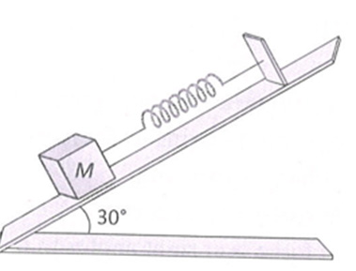
Class Assignment Question
A body of mass 5 kg is suspended by a spring balance on an inclined plane as shown in figure. The spring balance measure
1. 50 N 2. 25 N 3. 500 N 4. 10 N

Slide 21
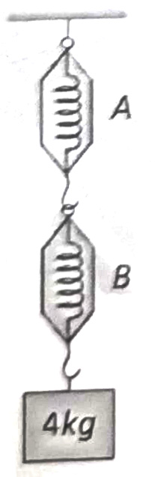
A block of mass 4 kg is suspended through two
light spring balances A and B. Then A and B
will read respectively
4 kg and zero kg
2. Zero kg and 4 kg
4 kg and 4 kg
4. 2 kg and 2 kg

Slide 22
Equilibrium of Concurrent Forces
If all the forces working on a body are acting on the same point, then they are said to be concurrent.
A body, under the action of concurrent forces, is said to be in equilibrium, when there is no change in the state of rest or of uniform motion along a straight line.
The necessary condition for the equilibrium of a body under the action of concurrent forces is that the vector sum of all the forces acting on the body must be zero.
Mathematically for equilibrium

Slide 23
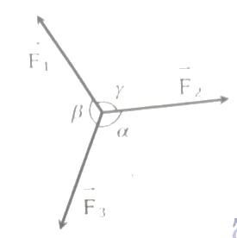
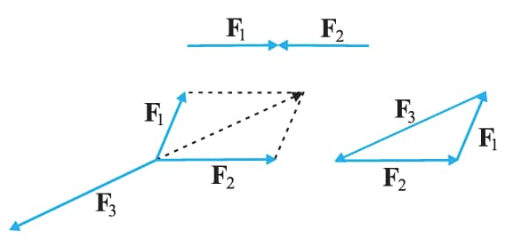
Equilibrium of Concurrent Forces
Lami’s Theroem : For concurrent forces
Note :
If the magnitude of force F₃ is between F₁ + F₂ and F₁ – F₂ then the system will be in equilibrium
F₁ – F₂ < F₃ < F₁ + F₂

Slide 24
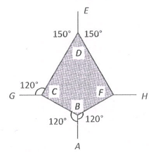
Class Assignment Question
The adjacent figure is the part of a horizontally stretched net. Section AB is stretched with a force of 10 N. The tensions in the sections BC and BF are
1. 10 N, 11 N
2. 10 N, 6 N
3. 10 N, 10 N
4. Can’t calculate due to insufficient data

Slide 25
2. Which of the following sets of concurrent forces may be in equilibrium?
1. F₁ = 3N, F₂ = 5 N, F₃ = 9 N 2. F₁ = 3N, F₂ = 5N, F₃ = 1N
3. F₁ = 3N, F₂ = 5N, F₃ = 15N 4. F₁ = 3N, F₂ = 5N, F₃=6N

Slide 26
Impulse and Impulsive Force
A large force acting on a body for a short interval of time is called impulsive force such forces cannot measure directly, but can be found out by knowing change in momentum.
Eg : Bat striking a cricket ball.
Collision between hammer and nail.
Impulse :
The product of large force and small interval of time for which the force act on the body is called impulse.

Slide 27
Impulse, I = Ft
unit → Nm Dimension → [MLT⁻¹]
Q.P.T impulse = Change in momentum
Let a constant force F act on abody for a small time t and change the velocity from u to v
According to Newtons 2nd law :
f = ma, f = ft = mv – mu,
ie I = mv – mu
Impulse = final momentum-Intial momentum
Impulse = change in momentum

Slide 28
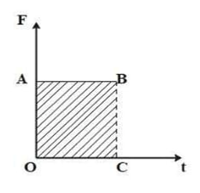

F-t Diagram
The are under the f-t diagram is given by
Area = length x breadth
Area = O.A x OC
Area = f x t
Area = Impulse
Thus the area under a F - t diagram gives impulse
Note : Impulse, I =

Slide 29
Class Assignment Question
If a force of 250 N act on body, the momentum acquired is 125 kg-m/s. What is the period for which force acts on the body
1. 0.5 s 2. 0.2 s 3. 0.4 s 4. 0.25 s

Slide 30
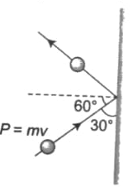
Q : A 100 g iron ball having velocity 10 m/s collides with a wall as an angle 30º and rebounds with the same angle. If the period of contact between the ball and wall is 0.1 second, then the force experienced by the wall is
1. 10N 2. 100N
3. 1.0N 4. 0.1N

Slide 31
Q : A bullet is fired from a gun. The force on the bullet is given by F = 600 – 2 x 105t where, F is newton and t in seconds. The fore on the bullet becomes zero as soon as it leaves the barrel. What is the average impulse imparted to the bullet?
1. 9 Ns 2. Zero 3. 1.8 Ns 4. 0.9 Ns

Slide 33
NEWTONS THIRD LAW OF MOTION
The law states that “to every action there is an equal and opposite reaction and they act on different bodies”.
Eg : When you step forward from rest, your feet pushes backward on earth.

Slide 34
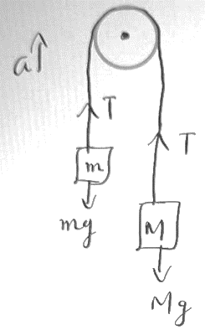
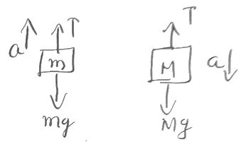
Problem Solving Strategy
(Connected Body and Pulley Problems)
Connected Body Problems :
a → acceleration of the system
T → Tension in the staring free body diagrams
Ma = Mg – T → 1 ma = T – mg → 2
(1) + (2)

Slide 35
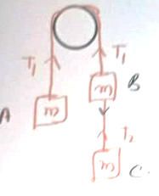
(Connected Body and Pulley Problems)
Q : Find the tension between A to B and B to C

Slide 36
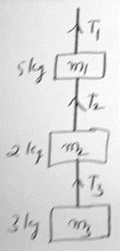
(Connected Body and Pulley Problems)
Q : Find tensions panting T₁, T₂ and T₃ when
(a) Whole the system going up with acceleration 2 m/s
(b) The whole system in stationary
m₁ = 5 kg m₂ = 2kg, m₃ = 3 kg

Slide 37
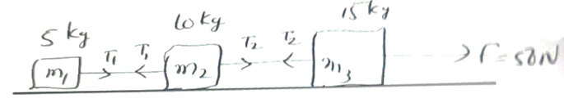
(Connected Body and Pulley Problems)
Q : Find out the tensions T₁ and T₂

Slide 38
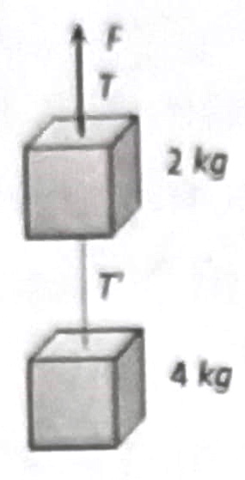
Class Assignment Question
Two blocks are connected by a string as shown in the diagram. The upper block is hung by another string. A force F applied on the upper string produces an acceleration of 2 m/s² in the upward direction in both the blocks. If T and T’ be the tensions in the two parts of the string, then
1. T = 70.8 N and T’ = 47.2 N
2. T = 58.8 N and T’ = 47.2 N
3. T = 70.8 N and T’ = 58.8 N
4. T = 70.8 N and T’ = 0

Slide 40
A rope of length L is pulled by a constant force F. What is the tension in the rope at a distance x from the end where the force is applied
1. 2. 3. 4.

Slide 41
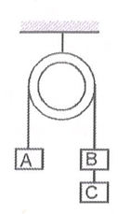
3. Three equal weights A, B, C of mass 2 kg each are hanging on a string passing over a fixed frictionless pulley as shown in the figure. The tension in the string connecting weights B and C is.
1. Zero 2. 13 Newton
3. 3.3 Newton 4. 19.6 Newton

Slide 42
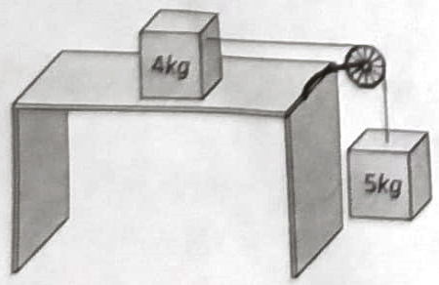
4. Two masses of 4 kg and 5 kg are connected by a string passing through a frictionless pulley and are kept on a frictionless table as shown in the figure. The acceleration of 5 kg mass is
1. 49 m/s² 2. 5.44 m/s²
3. 19.5 m/s² 4. 2.72 m/s²

Slide 43
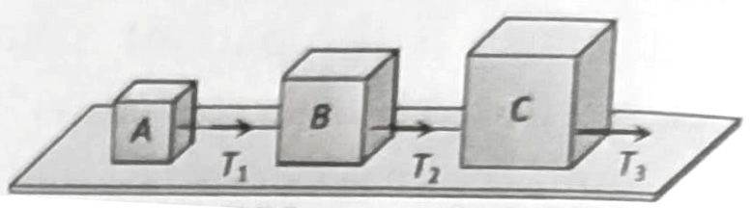
5. Three blocks A, B and C weighing 1, 8 and 27 kg respectively are connected as shown in the figure with an inextensible string and are moving on a smooth surface. T₃ is equal to 36 N. Then T₂ is
1. 18 N 2. 9 N 3. 3.375 N 4. 1.25 N

Slide 44
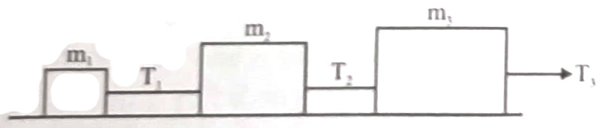
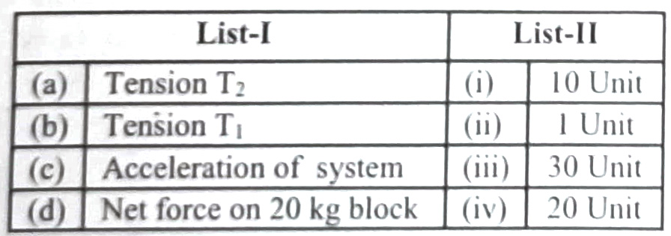
6. Three blocks are connected as shown, on a horizontal frictionless table and pulled to the right with a force T₃ = 60 N. If m₁ = 10 kg, m₂ = 20 kg and m₃ = 30 kg, then match list-I with
list – II and select the correct answer.

Slide 45
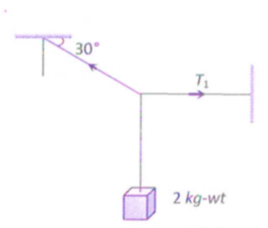
7. A body of weight 2 kg is suspended as shown in the figure. The tension T₁ in the horizontal string (in kg wt) is
1. 2/ 2. / 2 3. 2 4. 2

Slide 46
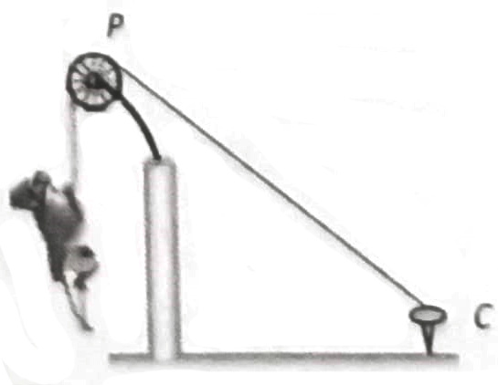
8. One end of a massless rope, which passes over a massless and frictionless pulley P is tied to a hook C while the other end is free. Maximum tension that the rope can bear is 360 N. With what value of minimum safe acceleration (in ms⁻²) can a monkey of 60 kg move down on the rope.
1. 16 2. 6 3. 4 4. 8

Slide 47


CONTACT FORCE
f → contact Force
Free Body Diagrams
Now from (Fig. b) Contact Force is given by f = m₂ a
But common acceleration a =
Also the not force on m₁ is given by F_{net} = F - f

Slide 48
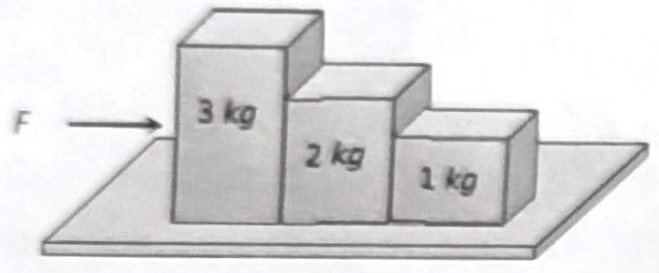
Class Assignment Question
Consider the following statements about the blocks shown in the diagram that are being pushed by a constant force on a frictionless table
A. All blocks move with the same acceleration
B. The net force on each block is the same. Which of these statements are/is correct
1. A only 2. B only
3. Both A and B 4. Neither A nor B

Slide 49
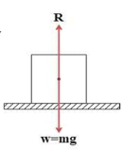
Apparent Weight of a Body in a lift
  Consider a body of mass m kept in a lift at rest, the forces acting in the body are
a) The weight of the body mg acting vertically downwards.
b) The reaction R acting verticayupwards.
The resultant force, F = R = mg, But according to newtons 2nd law F = ma
ma = R – mg

Slide 50
Case (1)
Suppose the lift is at rest
we have ma = R – mg (1)
Here a = 0 since the lift is at rest
Now eqn (1) → 0 = R – mg (or) R = mg
Case (2)
Suppose lift is moving up or down with uniform velocity (constant velocity)
we have ma = R – mg (1)
Here also a = 0 since velocity is a constant
Now eqn (1) → 0 = R – mg (or) R = mg

Slide 51
Case (3)
The lift is moving up with uniform acceleration a
we have ma = R – mg
R = ma + mg ; R = m(g + a)
Case (4)
The lift is moving down with uniform accelerations
Here ma = mg – R ( mg > R) R=mg–ma; R=m(g–a)
Here R = m(g + a) and R = m(g – a) are the apparent weights of a body in a lift when it accelerates up and down respectively.
Case (5)
Suppose the lift is under free fall. Then we have R = m(g – a)
When the lift is under free fall the acceleration will be equal to acceleration due to gravity (a = g)
Then R = m (g – g ) = 0
ie : The body feels weightlessness.

Slide 52
Class Assignment Question
A man is standing on a weighing machine placed in a lift. When stationary his weight is recorded as 40 kg. If the lift is accelerated upwards with an acceleration of 2 m/s², then the weight recorded in the machine will be (g = 10 m/s²)
1. 32 kg 2. 40 kg 3. 42 kg 4. 48 kg

Slide 53
Read the Statement – I and Statement – II carefully to mark the correct option out of the options given below.
Both Statement – I and Statement – II are correct
Statement – I is correct but Statement – II is incorrect
Statement – I is incorrect but Statement – II is correct
Both Statement – I and Statement – II are incorrect
Statement – I : In the case of free fall of the lift, the man will feel weightlessness
Statement – II : In free fall, acceleration of lift is equal to acceleration due to gravity

Slide 54
Law of conservation of momentum
According to Newtons 2nd law
F_{ert} = ;
If F_{ext} = 0,
Then P = a constant.
This is called law of conservation of momentum

Slide 55
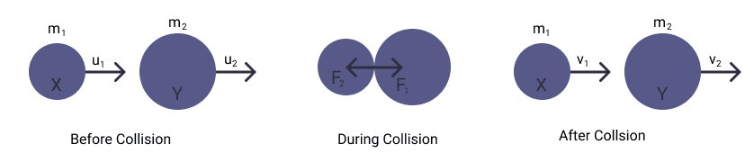

According to Newtons 3rd law
or m₁u₁ + m₂u₂ = m₁V₁ + m₂V₂
Total momentum Before collisim = Total momentum after collision

Slide 56
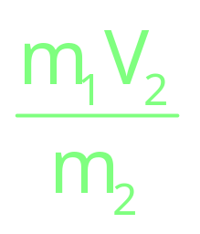
Note : Recoil velocity of Gun
Here Before giving u₁ = u₂ = 0 (Gun and shot are at Rest)
Then, m₁V₁ + m₂V₂ = 0
m₁ → mass of shot,
V₁ → muzzle velocity (Velocity of shot)
m₂ → mass of Gun,
V₂ → Recoil velocity (velocity of gun)
Recoil velocity V₂ = -

Slide 57
Class Assignment Question
A body of mass 5 kg explodes at rest into three fragments with masses in the ratio 1 : 1 : 3. the fragments with equal masses fly in mutually perpendicular directions with speeds of 21 m/s. The velocity of heaviest fragment in m/s will be
1. 7 2. 5 3. 3 4.

Slide 58
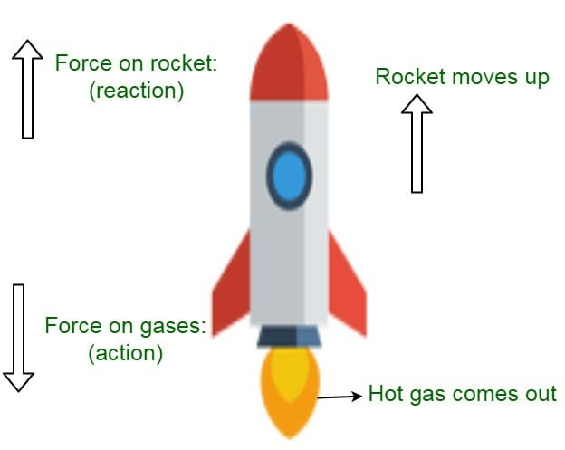
Variable Mass System (Rocket Propulsion)
Rocket propulsion is based on Newtons 3rd Law.
Rate of fuel buring =
m₀, v₀ → initial mass and velocity of rocket (at t = 0)
m, v → mass and velocity of rocket of ‘t’ time
U_{gR} or U → exhaust speed of burned gass (relative to rocket)
At time ‘t’ V > V₀ and m₁ coinstantaneous mass < m₀, u → constant

Slide 59
Results (Rocket Propulsion)
F_{exhast} = u. 2. F_{rocket} = -u. 3) |F_{exhast}| = |F_{rocket}|
4) Net Force and acceleration of rocket 5) Mass of Rocket at any
F_{net} = F_{rocket} – mg instant
m = m₀ – x t
ma = F_{rocket} – mg

Slide 60
Class Assignment Question
In a rocket of mass 1000 kg fuel is consumed at a rate of 40 kg/s. The velocity of the gases ejected from the rocket is 5 x 10⁴ m/s. The thrust on the rocket is
1. 2 x 10³ N 2. 5 x 10⁴ N
3. 2 x 10⁶ N 4. 2 x 10⁹ N

Slide 61
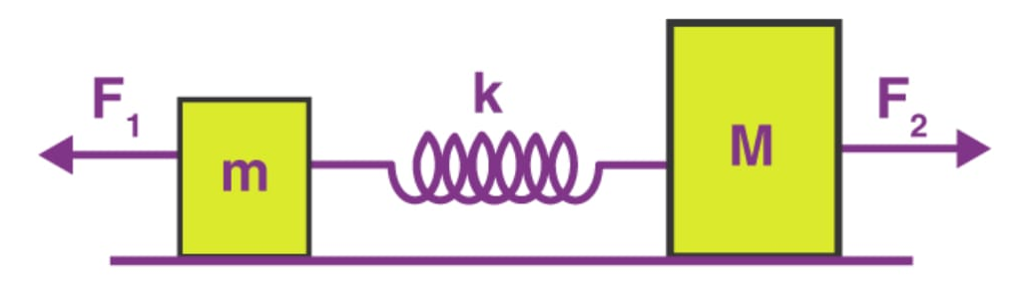
Spring Cutting Problems
Ideal Spring → A spring that obeys Hookes law and is also massless.
Since we assumed spring to be massless, the forces acting on both ends have to be equal and opposite. ( net force on the spring to be zero)
Blocks connected to the spring in different ends may have different acceleration.
Blocks connected to the some end of a spring have same acceleration
String → Tension Spring → Restoring Force

Slide 62
Spring Cutting Problems (Examples)

Slide 63

Class Assignment Question
The tension in the spring is
1. Zero 2. 2.5 N 3. 5 N 4. 10 N

Slide 64
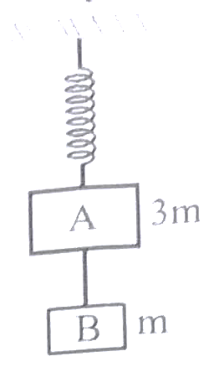
Previous Year Question
Two blocks A and B of masses 3m and m respectively are connected by a massless inextensible string. The whole system is suspended by a massless spring as shown in figure. The magnitudes of acceleration of A and B immediately after the string is cut, are respectively
1. , g
2. g, g
\ 3.
4. g,

Slide 65
Inertial and Non inertial Frame
Inertial Frame | Non-inertial Frame
a_{Frame} = 0 | a_{Frame} 0
Either rest or moving with constant velocity | Frame has same acceleration as that of the body
Newtons laws are valid for an observer in inertial frame | Newtons laws are not valid for observer in non inertial frame

Slide 66
Note : Pseudo Force
Apply only when observer is in non inertial frame (accelerated frame)
To make Newtons law correct, we intracule a new force called pseudo force.
F_{P} = - ma
Fp → Pseudo Force
a → acceleration of observer
-ve sign shows that pseudo force is opposite to the direction of observer.

Slide 67
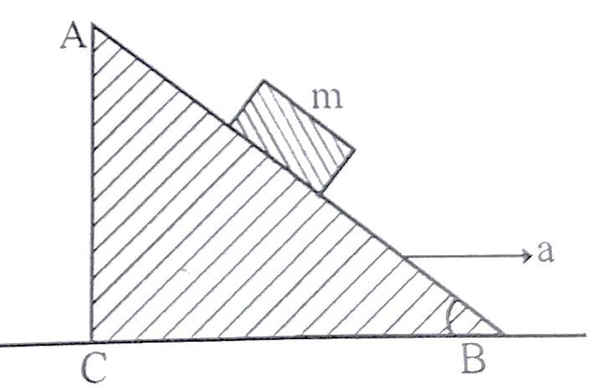
Previous Year Question
1. A block of mass m is placed on a smooth inclined wedge ABC of inclination θ as shown in the figure. The wedge is given an acceleration ‘a’ towards the right. The relation between a and θ for the block to remain stationary on the wedge is
1. a = g cos θ 2. a =
3. a = 4. a = g tan θ

Slide 68
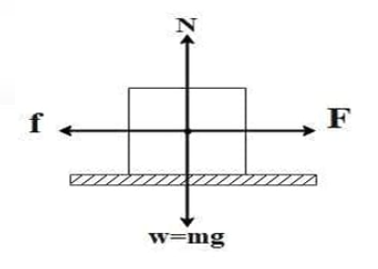
FRICTION
Friction is a self adjusting force
It always acts tangential to the surfaces in contact and opposite to the direction of motion.
Static Friction – Frictional force which balances the applied force
Limiting Friction – It is the maximum static friction

Slide 69
Note : Limiting Friction is independent of area of contact. It is directly proportional to the normal reaction.
F_{ms} N
or f_{ms} = μ_{s}N
μ_{s} → coefficient of static friction.
N = mg, for a Horizontal plane
N = mgcosθ, for an Inclined plane
Kinetic friction → It is the friction which comes into play when one body is in a steady state of motion over the surface of other.

Slide 70
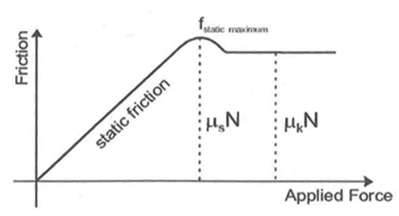
Note : Kinetic friction also independent of area of contact so long as the normal reaction remains constant.
It is directly proportional to normal reaction is f_{k} N
Or f_{k} = μ_{k}N
μ_{k} → coefficient of kinetic friction.

Slide 71
In general frictional force is directly proportional to normal reaction. That is f N
or f = μ N ; or μ = f/N
μ → coefficient of friction.
Note : Static friction is not always greater than Kinetic friction. But Coefficient of static friction (μ_{s}) is always greater than coefficient of Kinetic friction (μ_{k})

Slide 72
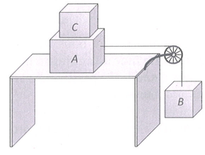
Class Assignment Questions
Two masses A and B of 10 kg and 5 kg respectively are connected with a string passing over a frictionless pulley fixed at the corner of a table as shown. The coefficient of static friction of A with table is 0.2. The minimum mass of C that may be placed of A to prevent it from moving is n figure.
1. 15 kg 2. 10 kg
3. 5 kg 4. 12 kg

Slide 73
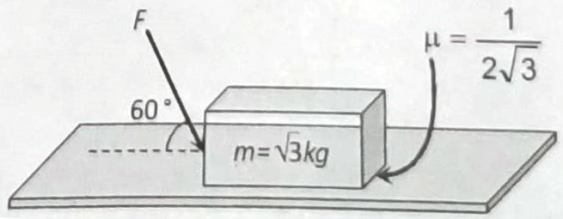
What is the maximum value of the force F such that the block shown in the arrangement, does not move
1. 20 N 2. 10 N 3. 12 N 4. 15 N

Slide 74
A car is moving along a straight horizontal road with a speed v₀. If the coefficient of friction between the tyres and the road is μ, the shortest distance in which the car can be stopped is
1. 2. 3. 4.

Slide 75
A block of mass 10 kg is placed on a rough horizontal surface having coefficient of friction m = 0.5. If a horizontal force of 100 N is acting on it, then acceleration of the block will be
1. 0.5 m/s² 2. 5 m/s² 3. 10 m/s² 4. 15 m/s²

Slide 76
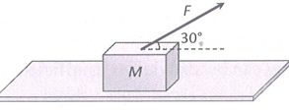
A Block of mass M = 5 kg is resting on a rough horizontal surface for which the coefficient of friction is 0.2. When a force
F = 40 N is applied, the acceleration of the block will be (g = 10 m/s₂)
5.73 m/sec² 2. 8.0 m/sec²
3. 3.17 m/sec² 4. 10.0 m/sec²

Slide 77
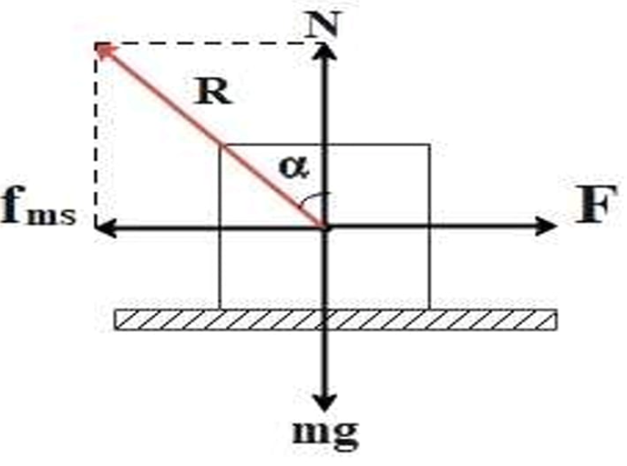
Angle of Friction (α)
α → Angle of friction
R → Resultant of fms and N
Now, tan ;
tan α = μ_{s}

Slide 78
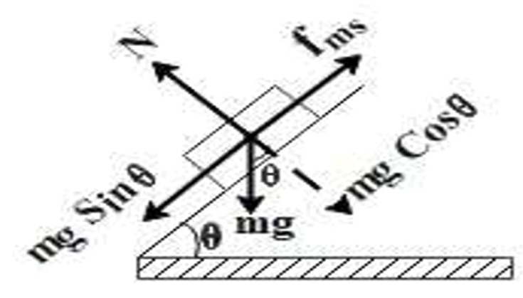
Angle of Friction (α)
It is the angle of the inclined plane at which an object placed on it just begins to move.
Now At angle of repose
mg sin θ = f_{ms} → (1)
mg cos θ = N → (2)
to tan θ = μ_{s}

Slide 79
Note :
a = g sin θ (for friction less inclined surface)
a = g sin θ – μg cos θ (for frictional inclined surface)
or a = g (sin θ – μ cos θ)

Slide 80
Class Assignment Questions
A block is lying on an inclined plane which makes 60º with the horizontal. If coefficient of friction between block and plane is 0.25 and g = 10 m/s², then acceleration of the block when it moves along the plane will be
1. 2.50 m/s² 2. 5.00 m/s²
3. 7.4 m/s² 4. 8.66 m/s²

Slide 81
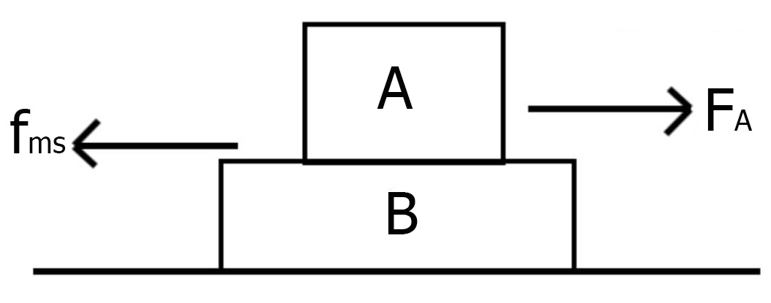
Block on Block Problem
If F_{A} f_{ms}, the two blocks moves together with common acceleration
If F_{A} > f_{ms}, then the blocks moves separately with different accelerations.
If they move separately then kinetic friction is involved. (f_{k} = μ_{k}N)

Slide 82
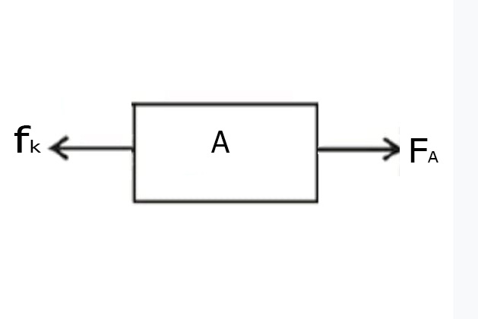
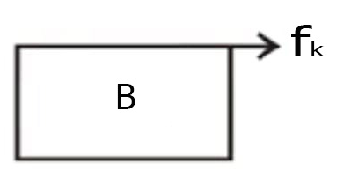
Then calculate acceleration separately by drawing free body diagrams
For Body A
a_{A} →
a_{A} =
a_{B} →
For Body B
f_{k} = μ_{k}N
m_{B} a_{B} = μ_{k}m_{A}g
a_{B} =

Slide 83
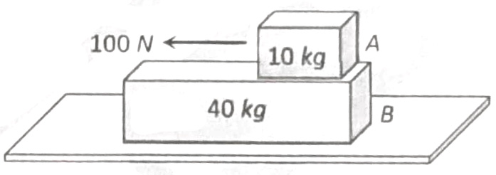
Class Assignment Questions
A 40 kg slab rests on a frictionless floor as shown in the figure. A 10 kg block rests on the top of the slab. The static coefficient of friction between is 0.40. The 10 kg block is acted upon by a horizontal force of 100 N. If g = 9.8 m/s², the resulting acceleration of the slab will be
1. 0.98 m/s² 2. 1.47 m/s²
3. 1.52 m/s² 4. 6.1 m/s²

Slide 85
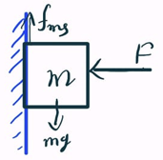
Block Against Vertical Wall
Calculate minimum force such that block does not slide on wall
Normal reaction N = F
f_{ms} = μ_{s} N
f_{ms} = μ_{s} F → (1)
But f_{ms} = mg
(1) → mg = μF
F =
Note: In such problems if maximum frictional force is greater than ‘mg’ then take the frictional fore as mg

Slide 86
Class Assignment Questions
A block of 1 kg is stopped against a wall by applying a force F perpendicular to the wall. If μ = 0.2 then minimum value of F will be
1. 980 N 2. 49 N 3. 98 N 4. 490 N

Slide 87
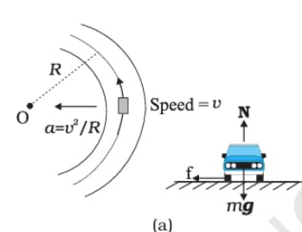

Motion of a car on a level Circular Road
The necessary centripetal force is provided by the frictional force between the road and type.
= f = μ N = μ mg
V² = μ rg
V =
Conclusion
The maximum speed with which a car turn safely is V_{max} .

Slide 88
Class Assignment Questions
An unbanked curve has a radius of 60 m. The maximum speed at which a car can make a turn if the coefficient of static friction is 0.75, is
1. 2.1 m/s 2. 14 m/s 3. 21 m/s 4. 7 m/s

Slide 89
2. When the road is dry and the coefficient of friction is μ, the maximum speed of a car in a circular path is 10 m/s, if the road becomes wet and μ’ = μ/2. What is the maximum speed permitted?
1. 5 m/s 2. 10 m/s 3. 10 m/s 4. 5 m/s

Slide 90
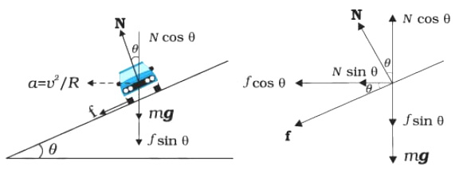
Motion of a Car on a Banked Circular Road
The maximum speed with which a car can turn through a Banked circular road is
where ‘μ’ is the coefficient of friction during motion with velocity V.

Slide 91
Conclusion :
The maximum possible speed of a car on a banked road is greater than that on a flat road.
Maximum speed with which a car can turn safely for zero friction (is m = 0) is

Slide 92
Class Assignment Questions
A road is banked at an angle of 30º to the horizontal for negotiating a curve of radius 10 m. At what velocity will a car experience no friction while negotiating the curve?
1. 54 km/hr 2. 72 km/hr
3. 36 km/hr 4. 18 km/hr

Slide 93
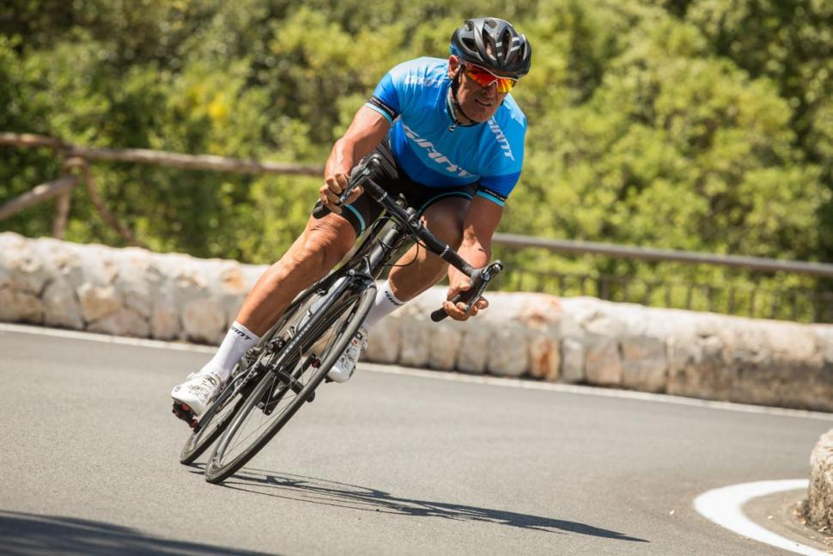
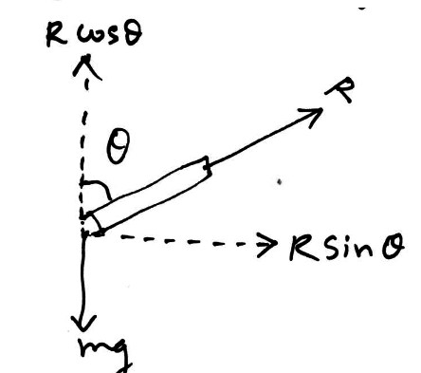
Bending of a cycle or turning
When a cyclist turn a road, he has to bend a little inward from the vertical position to secure the centripetal force necessary for turning or in other words the cyclist has to counteract the centrifugal force.
R sin θ =
R cos θ = mg
or tan θ =
θ is the angle with vertical.

Slide 94
The safe velocity of turning is
Note :
Horizontal component of Normal reaction R, provides the necessary centripetal force
Vertical component of normal reaction balances the weight mg.

Slide 95
Class Assignment Questions
A cyclist taking turn bends inwards while a car passenger taking same turn is thrown outwards. The reason is
1. Car is heavier than cycle
2. Car has four wheels while cycle has only two
3. Difference in the speed of the two
4. Cyclist has to counteract the centrifugal force while in the case of car only the passenger is thrown by this force

Slide 96
2. A motor cyclist moving with a velocity of 72 km/hour on a flat road takes a turn on the road at a point where the radius of curvature of the road is 20 meter. The acceleration due to gravity is 10 m/s². In order to avoid skidding, he must not bend with respect to the vertical plane by an angle greater than
1. θ = tan⁻¹ 6 2. θ = tan⁻¹ 2
3. θ = tan⁻¹ 25.92 4. θ = tan⁻¹ 4

Slide 97
Thanking You

